Slide 1
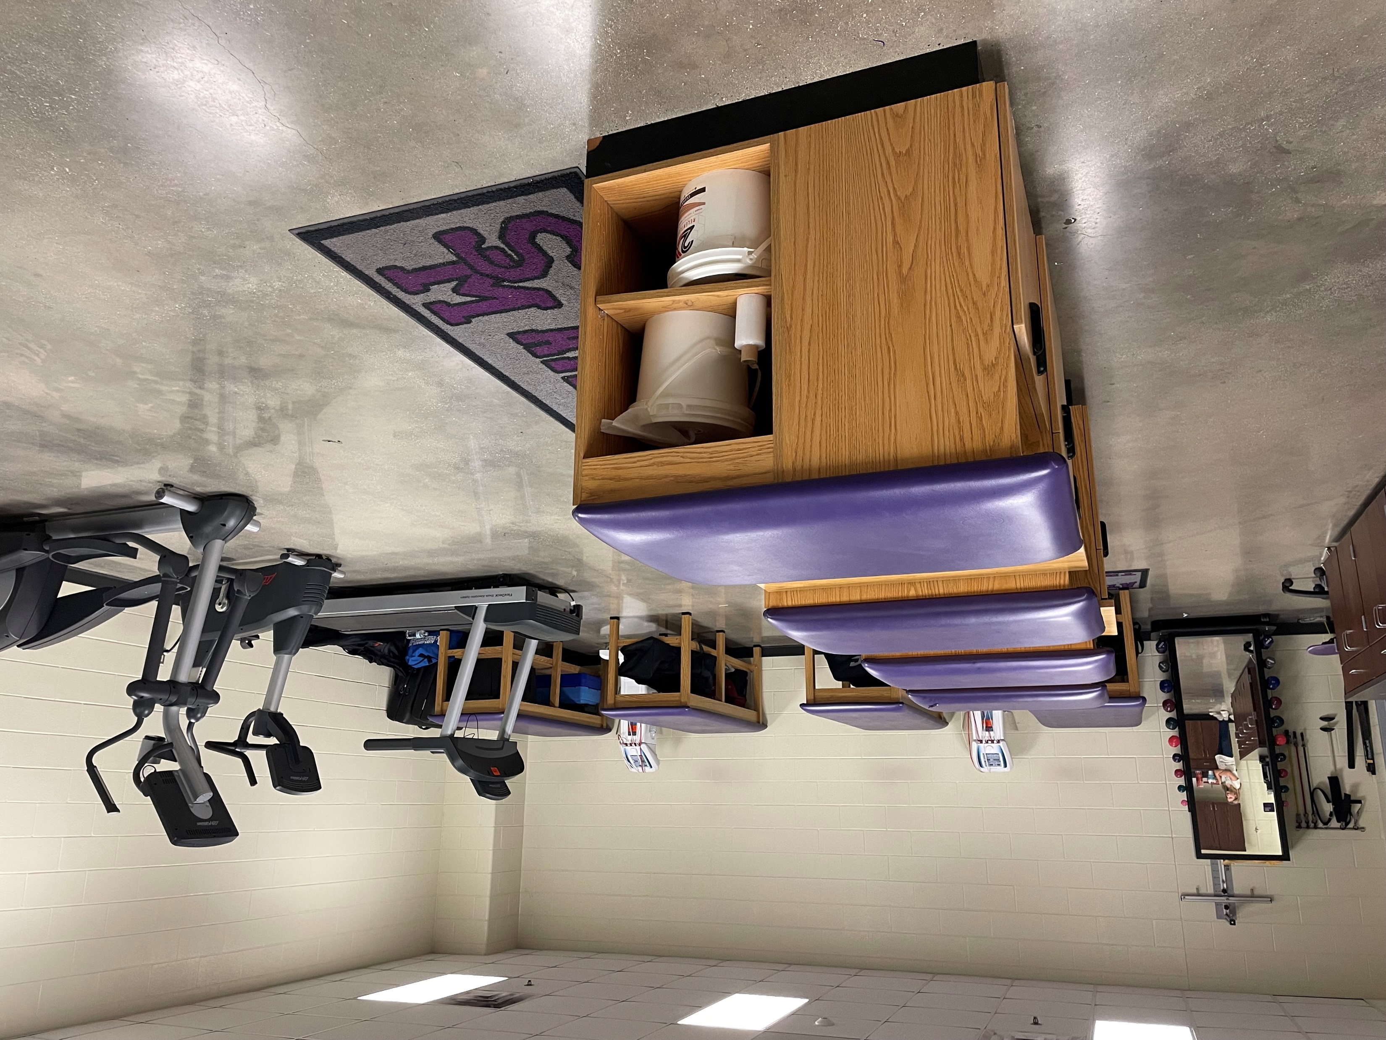
Exercise Science and Wellness
Statewide Program of Study
Health Science Career Cluster
The Health Science Career Cluster focuses on planning, managing, and providing therapeutic services, diagnostics services, health informatics, support services, and biotechnology research and development. To pursue a career in the health science industry, students should learn to reason, think critically, make decisions, solve problems, communicate effectively, and work well with others.
The Exercise Science and Wellness program of study introduces CTE learners to the fields that assist patients with maintaining physical, mental, and emotional health. Students will research diet and exercise needed to maintain a healthy, balanced lifestyle and learn about and practice techniques to help patients recover from injury, illness, or disease.
Work-Based Learning and
Expanded-Learning Opportunities
Secondary Courses for High School Credit
1 Principles of Health Science
2 Kinesiology I
3 Kinesiology II
Anatomy and Physiology
4 Career Preparation I
Exploration Activities | Work-Based Learning Activities
Participate in Health Occupations Students of America | Volunteer at a hospital or rehabilitation center Manage a school sports team
Industry-Based Certifications
Certified Personal Trainer
Postsecondary Opportunities
Associates Degrees
Physical Therapist Assistant
Physical Therapy Aides
Dietetic Technician
Bachelor’s Degrees
Kinesiology and Exercise Science
Therapeutic Recreation/Recreational Therapy
Athletic Training/Trainer
Master’s, Doctoral, and Professional Degrees
Exercise Physiology
Therapeutic Recreation/Recreation Therapy
Athletic Training/Trainer
Physical Therapist
SMHS Athletic Training Center
Aligned Occupations
Occupations | Median Wage | Annual Openings | % Growth
Athletic Trainers | $53,450 | 215 | 22%
Exercise Physiologists | $41,662 | 33 | 33%
Coaches and Scouts | $40,010 | 2,133 | 23%
Dieticians and Nutritionists | $57,762 | 428 | 24%
Recreational Therapists | $45,906 | 74 | 24%
Successful completion of the Exercise Science program of study will fulfill requirements of a Public Service endorsement or STEM endorsement if the math and science requirements are met. Revised – August 2022

Slide 2
Exercise Science and Wellness Course Information
COURSE NAME | SERVICE ID | PREREQUISITES | COREQUISITES
Principles of Health Science | 13020200 (1 credit) 6401 | None | None
Kinesiology I | N1302104 (1 credit) 7703 | Principles of Health Science | None
Kinesiology II | N1302124 (1 credit) TBD | Kinesiology I | None
Anatomy and Physiology | 13020600 (1 credit) 3266 | Biology and a second science credit | None
Career Preparation I | 12701300 (2 credits) 6910 | None | None
FOR ADDITIONAL INFORMATION ON THE HEALTH SCIENCE CAREER CLUSTER,
PLEASE CONTACT: CJ Odam, SMCISD CTE Coordinator cj.odam@smcisd.net
San Marcos CISD does not discriminate on the basis of race, color, national origin, sex, disability or age in its programs or activities and provides equal access to the Boy Scouts and other designated youth groups. The following person has been designated to handle inquiries regarding the nondiscrimination policies: Stephanie Munoz ; 631 Mill St, San Marcos, TX 78666 ; 512-393-6700 ; stephanie.munoz@smcisd.net
Further nondiscrimination information can be found at smcisd.net/cte

